Slide 1
COME! Grow with us!
“The unfolding of Your words gives light; It gives understanding to the simple.”
Psalm 119:130

Slide 2
Don’t Worry
(Be Happy, Be of Good Cheer)
The Zanesville church of Christ
–––––––––––––––––––––––––––
Presentation by: Mark Householder
Sunday a.m. 14 April 2024

Slide 3
Don’t Worry
“as to what to say”
• John 12:49
49 "For I did not speak on My own initiative, but the Father Himself who sent Me has given Me a commandment as to what to say and what to speak.

Slide 4
Don’t Worry
“about how or what you are to say”
• Matthew 10:19 (c.f. Mk. 13:11; Lk. 12:11)
19 "But when they hand you over, do not worry about how or what you are to say; for it will be given you in that hour what you are to say.

Slide 5
Don’t Worry
“'What will we eat?' or 'What will we drink?' or 'What will we wear for clothing?’…”
• Matthew 6:31-34
31 "Do not worry then, saying, 'What will we eat?' or 'What will we drink?' or 'What will we wear for clothing?'
32 "For the Gentiles eagerly seek all these things; for your heavenly Father knows that you need all these things.
33 "But seek first His kingdom and His righteousness, and all these things will be added to you.
34 "So do not worry about tomorrow; for tomorrow will care for itself. Each day has enough trouble of its own.

Slide 6
Don’t Worry
“not ashamed”
• Romans 1:16
16 For I am not ashamed of the gospel, for it is the power of God for salvation to everyone who believes, to the Jew first and also to the Greek.

Slide 7
* “nothing is better than…”
“than that man should be happy in his activities”
• Ecclesiastes 3:20-end
20 All go to the same place. All came from the dust and all return to the dust.
21 Who knows that the breath of man ascends upward and the breath of the beast descends downward to the earth?
22 I have seen that nothing is better than that man should be happy in his activities, for that is his lot For who will bring him to see what will occur after him?

Slide 8
Be Happy
“I am convinced that He is able”
• 2 Timothy 1:12-16
12 For this reason I also suffer these things, but I am not ashamed; for I know whom I have believed and I am convinced that He is able to guard what I have entrusted to Him until that day.

Slide 9
Be Happy
“He is not ashamed to call them brethren”
That’s us!
• Hebrews 2:11
11 For both He who sanctifies and those who are sanctified are all from one Father; for which reason He is not ashamed to call them brethren,

Slide 10
Be Happy
“God is not ashamed to be called their God”
That’s us, too!
• Hebrews 11:16
16 But as it is, they desire a better country, that is, a heavenly one Therefore God is not ashamed to be called their God; for He has prepared a city for them.

Slide 11
…but be careful!
Our lives do not consist of our possessions!
• Luke 12:11-34
15 Then He said to them, "Beware, and be on your guard against every form of greed; for not even when one has an abundance does his life consist of his possessions."

Slide 12
…but be careful!
Our lives do not consist of our possessions!
• Luke 12:11-34
16 And He told them a parable, saying, "The land of a rich man was very productive.
17 "And he began reasoning to himself, saying, 'What shall I do, since I have no place to store my crops?'
18 "Then he said, 'This is what I will do: I will tear down my barns and build larger ones, and there I will store all my grain and my goods.
19 'And I will say to my soul, "Soul, you have many goods laid up for many years to come; take your ease, eat, drink and be merry."'
20 "But God said to him, 'You fool! This very night your soul is required of you; and now who will own what you have prepared?’

Slide 13
…but be careful!
“but unless you repent, you will all likewise perish.”
• Luke 13:3-5
3 "I tell you, no, but unless you repent, you will all likewise perish.
4 "Or do you suppose that those eighteen on whom the tower in Siloam fell and killed them were worse culprits than all the men who live in Jerusalem?
5 "I tell you, no, but unless you repent, you will all likewise perish.”

Slide 14
…but be careful!
“repent and do the deeds you did at first…”
• Revelation 2:5
5 'Therefore remember from where you have fallen, and repent and do the deeds you did at first; or else I am coming to you and will remove your lampstand out of its place--unless you repent.

Slide 15
Therefore,
If you are in the Lord,…
Do not worry about worldly things.
Be happy in the Lord!
Take heed; be careful.
Remember Whose you are;
repent when you fall and do good.

Slide 16
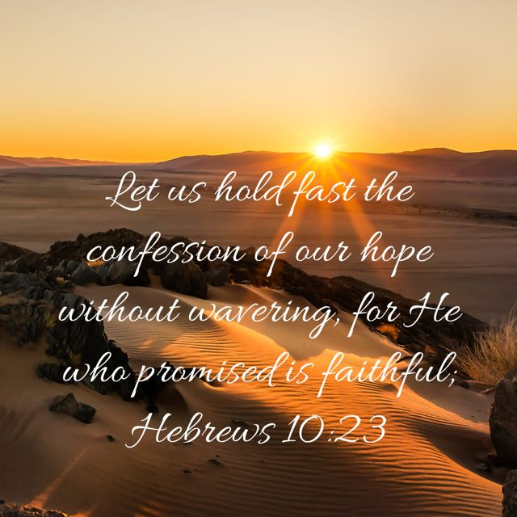
Salvation
1. Hear: Mt 7:24-27, Ro 10:17.
2. Believe: Mk 16:15-16, Heb 11:6, (Not faith only - Jn 12:42, Jas 2:24).
3. Repent: Lk 13:3, Ac 2:38, 17:30.
4. Confess: Mt 10:32-33, Ac 8:36-37, Ro 10:9.
5. Be baptized: Ac 2:38. See also “Baptism.”
6. Remain Faithful: Ro 8:1-17, Rev 2:10.
Is there any part of this that is not a matter of obedience which comes from faith?

Slide 17
The Zanesville church of Christ
Sunday Bible Study at 10 AM.
Worship at 11 AM & 6:30 PM.
Wednesday Bible Study at 6:30 PM.
COME! Grow with us!
“The unfolding of Your words gives light; It gives understanding to the simple.”
Psalm 119:130

